Slide 1


Version Control Systems

Slide 2



Course : Mastering DevOps
Lecture On : Version Control Systems
Instructor: Dipesh Garg

Slide 3
AGENDA
What, why, and how of version control
Centralized vs distributed version control
Git: Introduction
Basic Git concepts
Setting up Git
Git commands
Git: Good practices

Slide 4
WHAT IS VERSION CONTROL?
A system that records changes made to files
Provides control over these changes
Every change is tracked
  Why a change occurred
  References to a problem fixed
  Who introduced an issue and when
  Revert to a previous state

Slide 5
WHY DO WE NEED IT?
Version tracking
Maintaining multiple versions of software
Coordinating within/between teams
Data protection
Experimenting without interference

Slide 6
Version Control Systems: Background

Slide 7

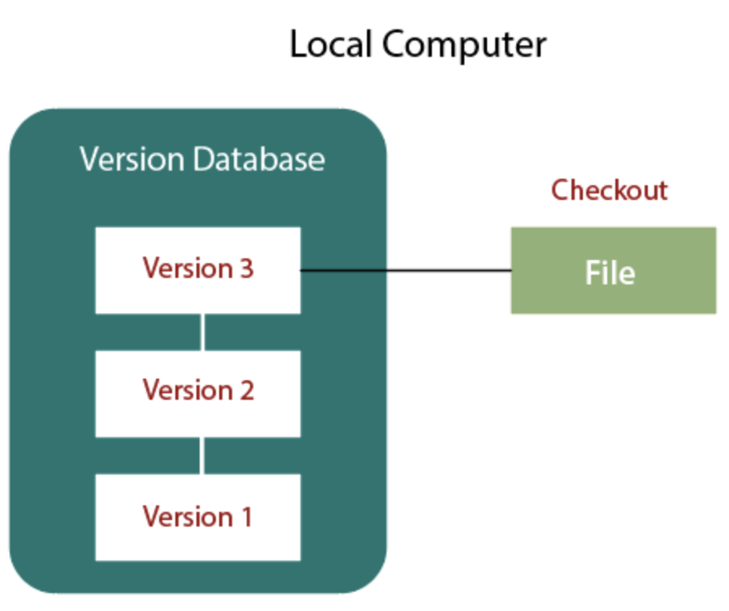


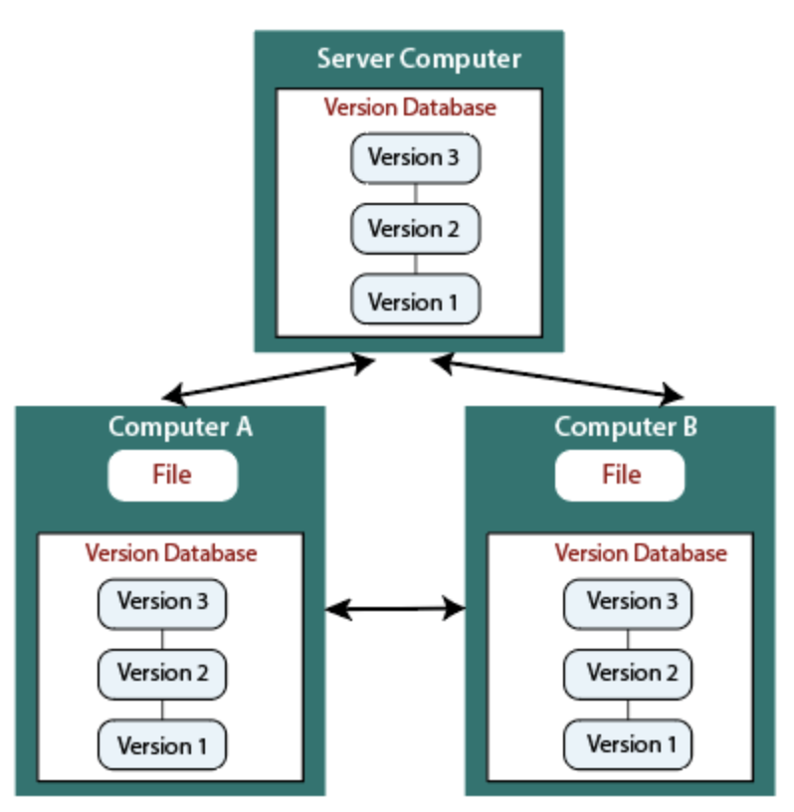
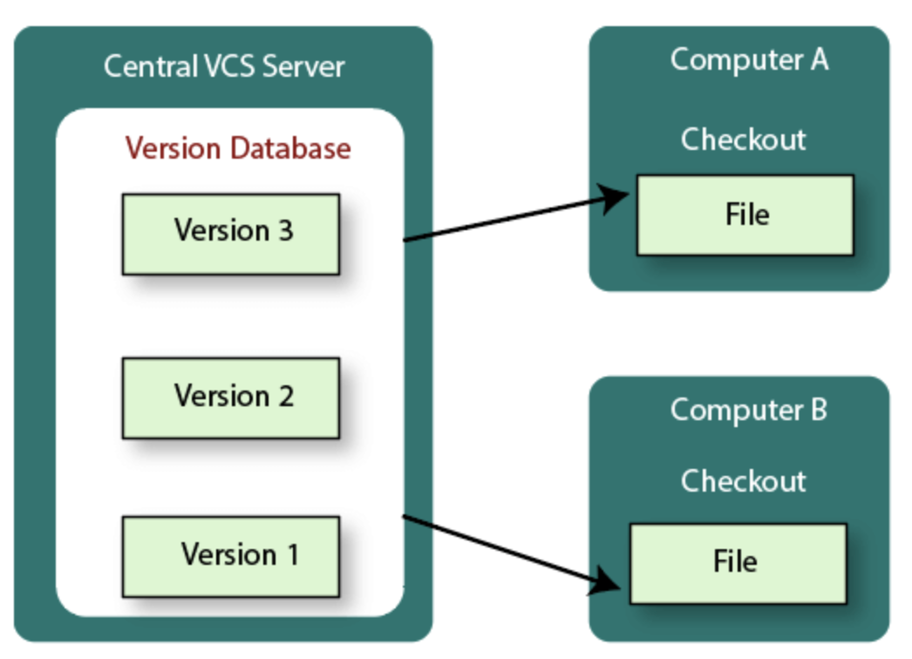
TYPES OF VERSION CONTROL SYSTEMS
LOCAL VCS
CENTRALIZED VCS
DISTRIBUTED VCS

Slide 8
LOCAL VERSION CONTROL SYSTEMS
Local Computer
Version Database
Check Out
Version 3
File
Version 2
Version 1

Slide 9
What if a developer needs to collaborate with other developers?

Slide 10
What if a local Database, hard disk, or machine crashes?

Slide 11
CENTRALIZED VERSION CONTROL SYSTEMS
Central VCS Server
Computer A
Version Database
Check Out
File
Version 3
Version 2
Computer B
Check Out
Version 1
File

Slide 12
DISADVANTAGES OF A CENTRALIZED SYSTEM
Single point of failure
If the hard disk gets corrupted without proper backup, all the data is lost

Slide 13
DISTRIBUTED VERSION CONTROL
Every developer has a copy of a version
A full version history is stored on the hard drive
This is faster, except for remote repository operations

Slide 14
DISTRIBUTED VERSION CONTROL SYSTEMS
Server Computer
Version Database
Version 3
Version 2
Version 1
Computer A
Computer B
File
File
Version Database
Version Database
Version 3
Version 3
Version 2
Version 2
Version 1
Version 1

Slide 15



DISTRIBUTED VERSION CONTROL SYSTEMS
Git
Mercurial
Perforce
BitKeeper

Slide 16
CENTRALIZED VS DISTRIBUTED SYSTEMS
http://www.youtube.com/watch?v=_yQlKEq-Ueg

Slide 17


WHAT IS GIT?
Git is a version control software
It keeps track of all the changes made to a project

Slide 18
GIT: INTRODUCTION
Developed and designed by Linus Torvalds
Very high performance
Offers a strong safeguard against accidental changes

Slide 19
GIT: CHARACTERISTICS
Strong support for non-linear development
Fully distributed
Efficient handling of large projects
Simple design

Slide 20
BASIC GIT CONCEPTS
Git has the following three states for files:
Committed: It means the data is safely stored in a local database
Modified: It means the file is changed but not committed to the database yet
Staged: It means the file is marked to go into the next commit snapshot

Slide 21
BASIC GIT CONCEPTS
Commit
  Is a snapshot
  Represents the checked-in version of files/directories
  Is uniquely identified by a 40-char string
  Has a reference to the parent commit
  Has a tree-based structure when branching

Slide 22
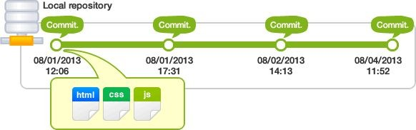
BASIC GIT CONCEPTS

Slide 23
BASIC GIT CONCEPTS
Working tree and index
Working tree: Consists of files you are currently working on
Index: A staging area where new commits are prepared and acts as an interface between the repository and working tree
The changes made to the working tree will not be committed directly to the repository. They need to be staged on the index first

Slide 24
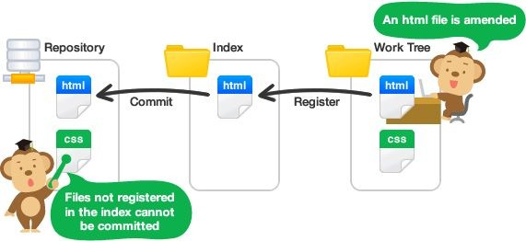
BASIC GIT CONCEPTS

Slide 25
BASIC GIT CONCEPTS
Remote repository and local repository
Remote repository: A repository that resides on a server and is shared among all team members
Local repository: A repository that resides on an individual’s local machine

Slide 26
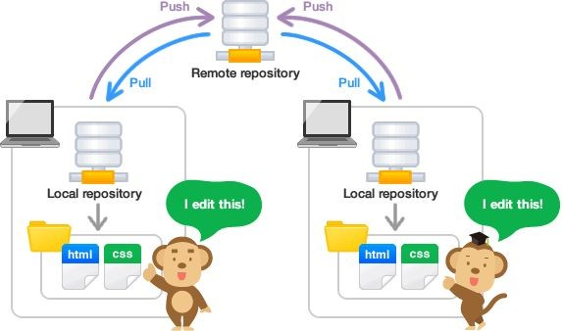
BASIC GIT CONCEPTS

Slide 27
BASIC GIT CONCEPTS
Remote repository - Remote
  It is possible to have more than one repository
  It is an alias for each repository
  Update from it with fetch and pull commands
  Send updates with push commands

Slide 28
BASIC GIT CONCEPTS
Branch
  It is an active line of development
  The most recent commit on a branch is called a “tip”
  A single Git repository can track an arbitrary number of branches
  A working tree is associated with one of them, and the HEAD points to that branch

Slide 29
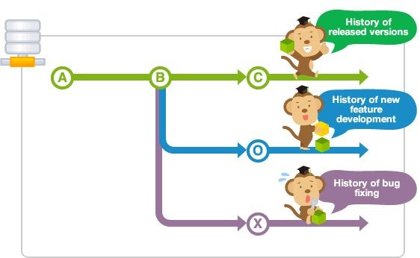
BASIC GIT CONCEPTS

Slide 30
BASIC GIT CONCEPTS
Merge conflict
  The same line in a file can be edited by multiple people or in different branches
  Git is intelligent in case the changes are in different line numbers in a file

Slide 31
SETTING UP GIT
Sudo apt-get intall git
Git needs your SSH public key to allow pushing and pulling
git config –global user.name <name>
git config –global user.email <email>

Slide 32
GIT COMMANDS
init: Initialize a directory as a Git repository
add: Add a file to Git
rm: Remove a file from Git
commit: Commit staged files
checkout: Check out files/branches
branch: View branches
push: Update the remote repo with the changes made to the local repo
pull: Update the local repo with the changes made to the remote repo

Slide 33
HOW TO USE GIT AND GITHUB?
Create a “repository” (project) with GitHub
Copy (or clone) the repository to your local machine
Add a file to your local repo and “commit” (save) the changes
“Push” your changes to your main branch
Make a change to your file with a Git hosting tool and commit
“Pull” the changes to your local machine
Create a “branch” (version), make a change, and commit the change
Open a “pull request” (propose changes to the main branch)
“Merge” your branch to the main branch

Slide 34
GIT COMMANDS
stash: Manage the stash
remote: Manage a set of tracked repositories
merge: Merge changes
Resolving merge conflicts:
  Edit files
  Add edited files
  Commit files

Slide 35
FLOW IN GITHUB
Local Repository
Git Add
Git Commit
Git Push
Working Copy
Staging Area
Local Version Database
Remote Server
(GitHub)

Slide 36
REVERT AND RESET
Git Reset
Commit 1
Commit 2
Commit 3
Commit 4
Git Revert

Slide 37
BRANCHING
Commit 1
Commit 2
Commit 6
Merging
Commit 3
Commit 4
Commit 5

Slide 38

What is open source?

Slide 39
WHAT IS OPEN SOURCE?
Decentralized software development
Peer collaboration
Companies such as Google, Facebook, and Microsoft have open sourced their projects
Popular libraries such as NumPy, Pandas, and TensorFlow are open sourced

Slide 40
Why is open-source contribution helpful?

Slide 41
WHY IS OPEN-SOURCE CONTRIBUTION HELPFUL?
Contributes to real-world applications
Has a short learning curve and an efficient code structure and coding style
Builds a network of developers
Can be leveraged for your career growth

Slide 42
COLLABORATION
Git Fork
(copy to private)
Git Clone
Private Repo
GitHub Repo
(open source)
Local Changes
Pull
Request
Git
Push
Private Repo

Slide 43
IGNORING FILES IN GIT
.gitignore: Not a command but a file consisting of file names that should not be checked in the VCS. This file will be checked in the VCS

Slide 44
GIT: GOOD PRACTICES
Atomic commits
Meaningful commit messages
Use of gitignore

Slide 45
GIT REFERENCES
Git Manual page
Git cheat sheet
https://www.codeschool.com/courses/git-real

Slide 46
Doubt Clearance Window

Slide 47
Tasks to Complete After Today’s Session
MCQs
Conceptual Questions
Project Checkpoint

Slide 48
Thank You!

